Slide 1
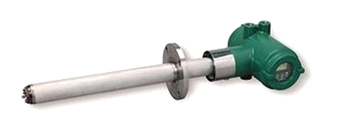
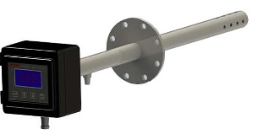
l- Industrial Zirconia Oxygen Probe-

Slide 2
Contents
Introduction – slide 3
Material Science Tetrahedral – slide 4
Structure – slide 5-7
Stabilization- slide 8
Yttria Stabilized Zirconia – slide 9-10
Structure of YSZ - slide 11
Properties of YSZ- slide 12-13
Manufacturing of YSZ – slide 14-15
Microstructure of YSZ- slide 16
Electrical properties of YSZ- slide 17
Fabrication of O₂ sensor – slide 18-19
Applications – slide 20
Zirconia Oxygen Analyzer- Working principle – slide 21-25
Personal Experience – slide 26-27
References –slide 28

Slide 3
Introduction
A Zirconia oxygen probe is a sensor used for measuring the concentration of oxygen in industrial application.
The sensing element used is a Yttria Stabilized Zirconia sensor.
This presentation attempts to describe the material tetrahedral of the sensing element which is drawn in the next slide.

Slide 4
Material Tetrahedral
Structure
Properties
Application
Manufacturing

Slide 5
Structure
Zirconia or ZrO₂ has a melting point of 2677 ⁰C [1] and a boiling point of 4371 ⁰C
Above till melting point
Cubic
1174 ⁰C
2377 ⁰C [1]
Monoclinic
2377 ⁰C
Below
Tetragonal
1174 ⁰C [1]

Slide 6
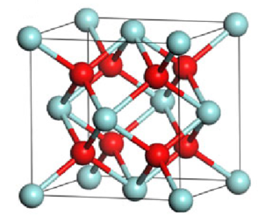
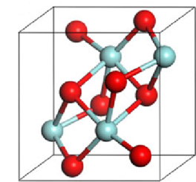
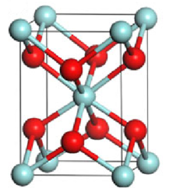
Structure
Zr atom (blue)
Oxygen atom (red)
Oxygen atom (red)
Zr atom (blue)
Fig. 1 Cubic Structure
Zr atom (blue)
Fig. 3 Monoclinic Structure
Oxygen atom (red)
Fig. 2 Tetragonal Structure

Slide 7
Can pure ZrO₂ be used as it is ?
Tetragonal to monoclinic phase transformation is accompanied by a volume increase of 4-6%.
The shear strain increases by about 1-2%.
Any attempt to make a dense wafer will fail as pure zirconia body disintegrates on cooling thus shattering it into a powder [1].
Cannot be used in pure form !

Slide 8
Stabilization of Zirconia
Doping Zirconia with lower valence oxides such as CaO, MgO, La₂O₃, and Y₂O₃, disfavoures the strained m phase at room temperature and favours more symmetric cubic and tetragonal lattice structures. [2]
The most common dopant is Yttria (Y₂O₃).
Stabilization of the cubic polymorph of zirconia over wider range of temperatures is accomplished by replacement of some of the Zr⁴⁺ ions (ionic radius of 0.82 Å) in the crystal lattice with slightly larger ions, e.g., those of Y³⁺ (ionic radius of 0.96 Å).

Slide 9
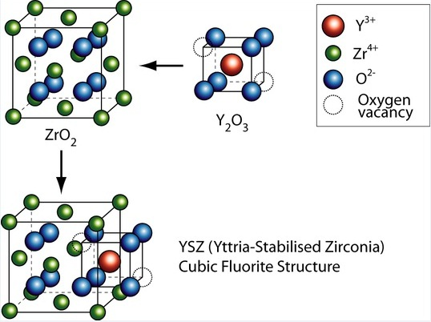
Yttria Stabilized Zirconia

Slide 10
Yttria Stabilized Zirconia
By the addition of yttria to pure zirconia (e.g., fully stabilized YSZ) Y³⁺ ions replace Zr⁴⁺ on the cationic sub lattice. Thereby, oxygen vacancies are generated due to charge neutrality:
Y₂O₃ 2Y_{Zr} + 3O^{x}₀ + V₀..
which means two Y³⁺ ions generate one vacancy on the anionic sublattice. This facilitates moderate conductivity of yttria stabilized zirconia for O²⁻ ions (and thus electrical conductivity) at elevated and high temperature. This ability to conduct O²⁻ ions makes yttria stabilized zirconia well suited for application as solid electrolyte in solid oxide fuel cells and in gas sensing applications. [3]
A fully (cubic) stabilized zirconia is obtained with a Y₂O₃-content of 8 mol% with one oxygen vacancy created for every two yttrium ions, while a Y₂O₃ content of about 2-6 mol% gives a partially stabilized zirconia [2].

Slide 11
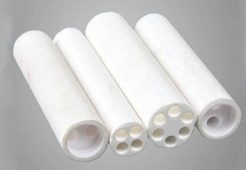
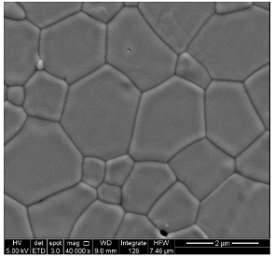
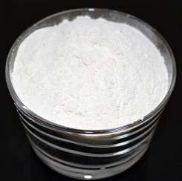
Structures of YSZ
Fig.4 YSZ Tubes
Fig.5 YSZ (8 mole %) microstructure
Fig.6 YSZ (8% mole) nanopowder

Slide 12
Properties of YSZ
PHYSICAL
Density: 5.85-6.10 gcc⁻¹
Water absorption: zero
MECHANICAL
Hardness: 8 Mohs
Compressive strength: 2200-2500 MPa
ELECTRICAL
Electrical resistivity : > 10¹² ohm cm
Dielectric strength: 9-19 kV/mm
Elastic Modulus: 200-210 GPa
Dielectric constant: 29
Dissipation factor: 0.001-0.002

Slide 13
Properties of YSZ
THERMAL
Thermal conductivity : 2.20- 2.50 W/mK
CTE linear: 10.3 – 11 μm/m ⁰C
COMPOSITION
Y₂O₃ : 3-12 %
ZrO₂ : 88-97 %

Slide 14
Manufacturing of YSZ
Steps for development of 8YSZ
Milling and powder mixing
92 mol % ZrO₂ and 8 mol % Y₂O₃ is milled and mixed together in powder form [4]
The resultant powder is calcined at 1350°C for 1 hour.
Further the powder is pressed using uniaxial die of 40 Mpa and then sintered at 1550⁰C for 4 hours to form cubic YSZ [4]. The powder is then cooled to form 8YSZ.
Calcination at 1350°C
Sintering at 1550⁰C followed by cooling

Slide 15
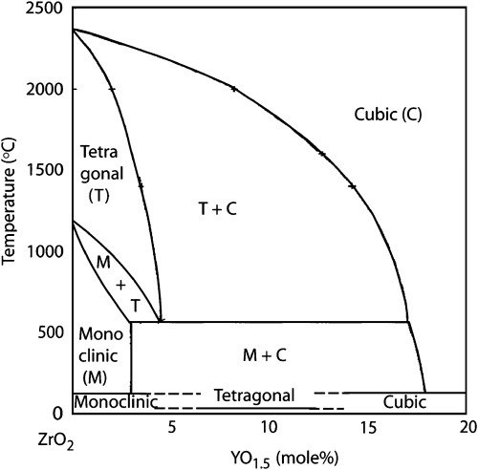
Manufacturing of YSZ
Polymorphs of YSZ can be obtained by changing the Yttria content.
Below 3 mole % of Yttria, YSZ is monoclinic at room temperature and hence is unusable.
Generally 8 mol % YSZ is found to be good enough for industrial application.
At more than 650⁰C, YSZ starts to conduct due to the formation and liberation of O²⁻ ions, and thus is useful in SOFCs and gas detectors.
Fig.7 Phase diagram of Yttria-Zirconia ceramic composite

Slide 16
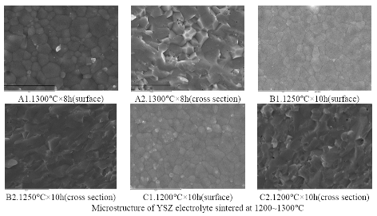
Microstructure of YSZ
In the dense YSZ sample, the grains are uniform and the grain boundaries are straight, clear and thin. [5]
From the surface microstructure there seems to be no pores or a very few no. of pores inside the grains
The pores are minute and enclosed, which have little effect on the electrical conductivities of YSZ. [5].
The grain size distribution of YSZ is in the range of 0.4-3μm, most of them are less than 1μm.
At the same sintering temperature, the grain size becomes bigger when the holding time is longer. With the same holding time, the grain size increases with the sintering temperature increasing. [5]

Slide 17
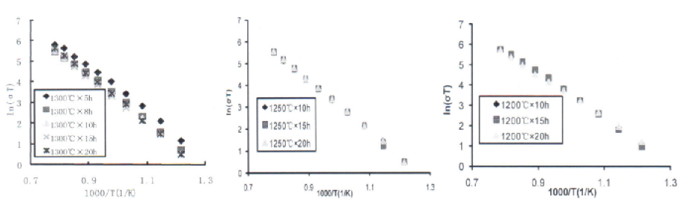
Electrical properties of YSZ
With decrease in grain size the electrical conductivity increases. [5].
The conductivity of solid electrolyte is made up of grain conductivity and grain boundary conductivity.
The conduction of oxygen ions decreases when the oxygen-vacancy concentration at the grain boundary is lower than in the grain interior.
In comparison of the electrical conductivities of YSZ sintered at different processes, the desirable sintering process is the 1200°C×10h, in which the electrical conductivities of YSZ are higher, i.e. 0.04s/cm at 800°C and about 0.2s/cm at 1000°C, than previously reported (0.006 600°C, 0.12s/cm at 1000°C [6].

Slide 18
Fabrication of Oxygen Sensor
Co-firing method of laminated ceramic sheets is employed to form a porous layer type sensor.
Oxygen sensors, composing of two plate type zirconia cells and Pt electrodes, are laminated at 70⁰C by a thick-film process and then sintered for 4 h at 1400⁰C [7].
Microstructure of surface and cross-section of the oxygen sensors was examined by a scanning electron microscope (SEM) [7].
The ratio of O₂/N₂ gas mixtures was controlled by varying O₂ content from 0 to 75 % by volume.

Slide 19
Fabrication of Oxygen Sensor
Fig.8 Schematics of (a) aperture type and (b) porous oxygen sensors [7]

Slide 20
Applications
There are several applications of YSZ. Some of the areas of application are listed as follows:
1. As tooth crowns for its hardness and chemical inertness.
2. As a refractory material, eg. jet engines.
3. As a thermal barrier coating in gas turbines.
4. As an electroceramic due to its ion-conducting properties, eg. determining O₂ conc. In exhaust gases, pH measurement etc.
5. Used in the production of solid oxide fuel cells (SOFC).
6. In bullet proof jackets.

Slide 21
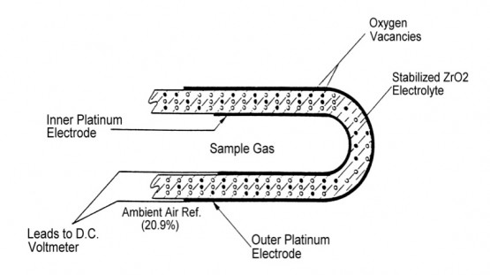
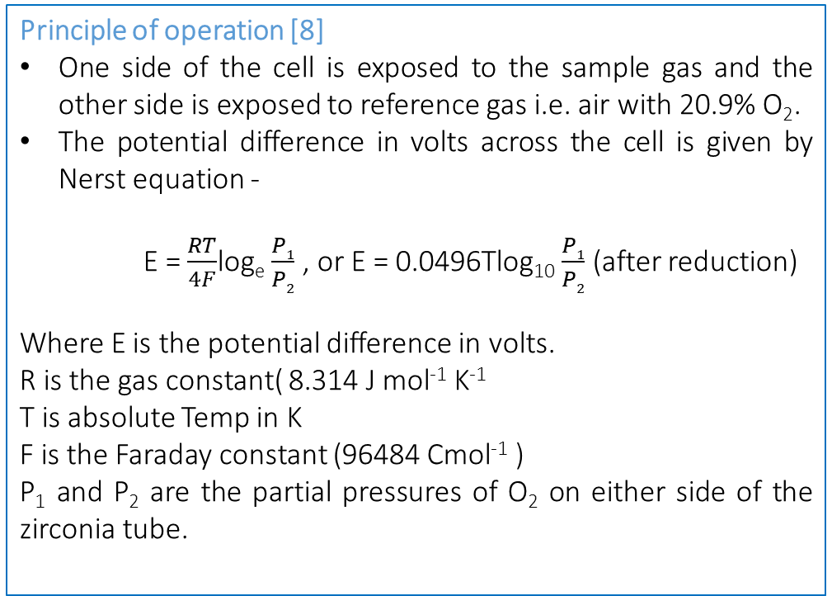
Zirconia Oxygen Analyzer
Principle of operation [8]
One side of the cell is exposed to the sample gas and the other side is exposed to reference gas i.e. air with 20.9% O₂.
The potential difference in volts across the cell is given by Nerst equation -
E = $\frac{RT}{4F}$log_{e} $\frac{P1}{P2}$ , or E = 0.0496Tlog₁₀ $\frac{P1}{P2}$ (after reduction)
Where E is the potential difference in volts.
R is the gas constant( 8.314 J mol⁻¹ K⁻¹
T is absolute Temp in K
F is the Faraday constant (96484 Cmol⁻¹ )
P₁ and P₂ are the partial pressures of O₂ on either side of the zirconia tube.
Fig. 9 cross section of the zirconia substrate

Slide 22
Zirconia Oxygen Analyzer
Principle of operation (contd.)
The partial pressure of the gas is equal to product of molar concentration of the component and the total gas pressure.
pO₂ = cO₂ p₂,
Where,
pO₂ = Oxygen partial pressure
cO₂ = Molar concentration of oxygen
p₂ = Total pressure
For atmospheric air
cO₂ = 20.9%
p₂ = 1 atmosphere
pO₂ = 0.209 x 1 = 0.209 atmospheres
Thus, if the oxygen partial pressure at one of the electrodes is known and the temperature of the sensor is controlled, then measurement of the potential difference between the two electrodes enables the unknown partial pressure to be calculated.

Slide 23
Zirconia Oxygen Analyzer
Principle of operation (contd.)
Molecular oxygen is ionized at the porous platinum electrodes
PtO Pt + ½ O₂
½ O₂ + 2e- O²⁻
The Pt electrodes act as catalytic surface for transformation of O₂ to O²⁻ ions and back to oxygen molecules.
Oxygen molecules on the high concentration reference gas side of the cell gain electrons to become ions which enter the electrolyte. Simultaneously, at the other electrode, oxygen ions lose electrons and are released from the surface of the electrode as oxygen molecules.
The mechanism of this ion transfer is complex, but it is known to involve vacancies in the zirconia oxide lattice doped with yttrium oxide (YSZ).

Slide 24
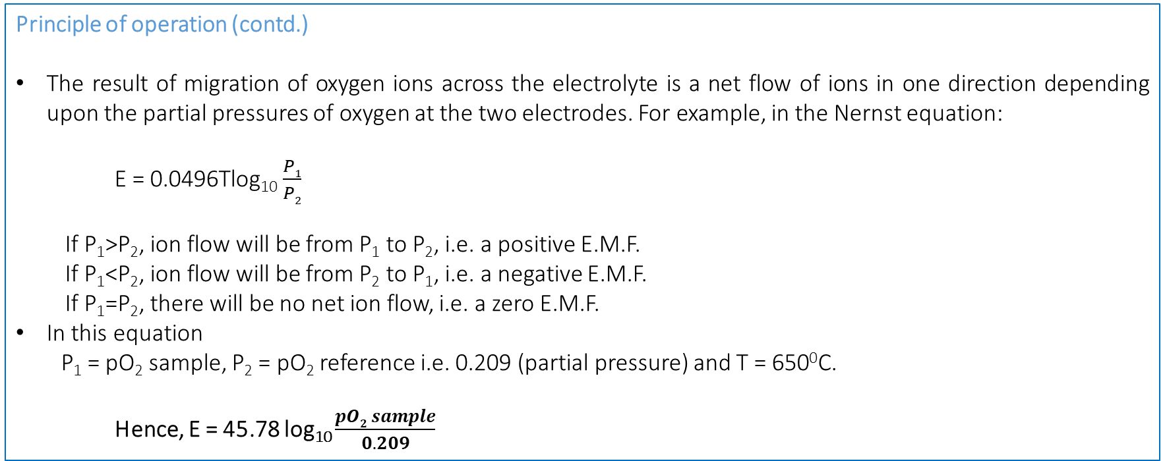
Zirconia Oxygen Analyzer
Principle of operation (contd.)
The result of migration of oxygen ions across the electrolyte is a net flow of ions in one direction depending upon the partial pressures of oxygen at the two electrodes. For example, in the Nernst equation:
E = 0.0496Tlog₁₀ $\frac{P1}{P2}$
If P₁>P₂, ion flow will be from P₁ to P₂, i.e. a positive E.M.F.
If P₁<P₂, ion flow will be from P₂ to P₁, i.e. a negative E.M.F.
If P₁=P₂, there will be no net ion flow, i.e. a zero E.M.F.
In this equation
P₁ = pO₂ sample, P₂ = pO₂ reference i.e. 0.209 (partial pressure) and T = 650⁰C.
Hence, E = 45.78 log₁₀ $\frac{pO2 sample}{0.209}$

Slide 25
Zirconia Oxygen Analyzer
Principle of operation (contd.)
The analyzer electronically calculates the oxygen partial pressure, and therefore oxygen concentration, of a sample gas with unknown oxygen concentration. This is accomplished by measuring the potential, E, produced across the zirconium cell electrodes, substituting for E in the Nernst equation and anti-logging to obtain PO₂. The cell potential output is shown in Fig. 10.
Fig. 10 cell potential vs O₂ conc.

Slide 26
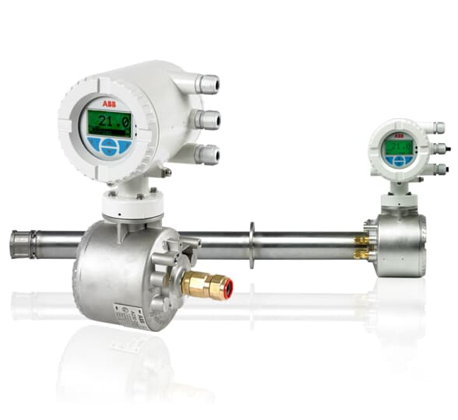
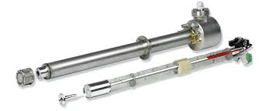
Personal Experience with O₂ analyzer
I have commissioned and used Endura AZ20 combustion gas oxygen analyzer (ABB made) in thermal power plant (Reliance Power).

Slide 27
Personal Experience with O₂ analyzer
The analyzer was installed at the Air preheater inlet of the boiler to measure O₂ concentration and thus determine whether sufficient Air to fuel ratio is maintained and combustion is stable inside the boiler. The temperature at this location was around 350-400⁰C.
Another such analyzer was installed at the stack (chimney) inlet where temperature was 140-200⁰C.
In either case, a reference air supply at 1.5-2 bar was provided to the instrument.
The analyzer requires periodic calibration with 99.99% pure O₂ every 3-6 months.
The instrument has an inbuilt heater which heats the zirconia sensor block to 650⁰C so that zirconia starts conducting electricity.

Slide 28
References
Han, Yong & Zhu, Junfa. (2013). ChemInform Abstract: Surface Science Studies on the Zirconia-Based Model Catalysts. Topics in Catalysis. 56. 10.1007/s11244-013-0156-5.
J. Robert Kelly, Isabelle Denry, Stabilized zirconia as a structural ceramic: An overview, Dental Materials, Volume 24, Issue 3, March 2008, Pages 289-298.
Hund, F (1951). "Anomale Mischkristalle im System ZrO2–Y2O3. Kristallbau der Nernst-Stifte". Zeitschrift für Elektrochemie und Angewandte Physikalische Chemie. 55: 363–366.
B Budiana et al 2016 J. Phys.: Conf. Ser. 739 012022
Han, Min & Yang, Z. & Liu, Ze & LE, HR. (2010). Fabrication and Characterizations of YSZ Electrolyte Films for SOFC. Key Engineering Materials - KEY ENG MAT. 434-435. 705-709. 10.4028/www.scientific.net/KEM.434-435.705.
R. N. Basu, G. Blass: J. Eur. Ceram. Soc. Vol. 25 (2005), p. 463–471.
Young-Jei Oh, I.-B. Shim, Deuk Yong Lee, A Novel Method for Manufacturing of Portable Oxygen Sensor, IEEE SENSORS 2006, EXCO, Daegu, Korea / October 22-25, 2006.
https://www.systechillinois.com/en/support/technologies/zirconia-oxygen-analysis
Wikipedia.

